Slide 1
Business Analytics Case Study Challenge
Data Science Summit’21, Society for Data Science, BIT Mesra
Team name – Data Geeks
Team Members:
Aman Mittal
Indrani Sen
Kajal Mahato
4. Ananyapam De

Slide 2
Introduction
With the current pandemic in place, a pharmaceutical company ‘ChemX’ is planning to roll out it’s own newly developed Covid-19 vaccine in the Indian market.
The company was established in 2020, currently holds 2% of the pharmaceutical market share in India and plans to use the current situation to expand its market share in the near future.

Slide 3
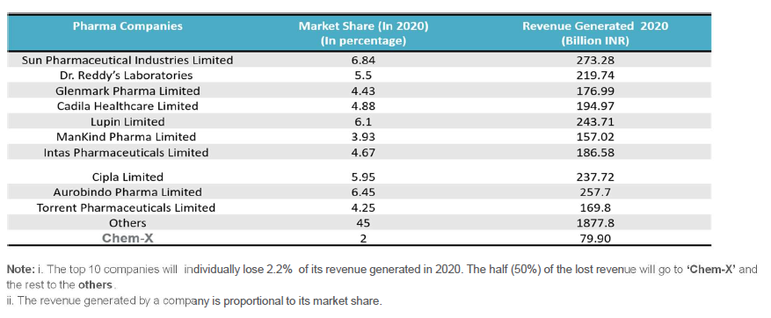
Market Opportunity for ChemX

Slide 4
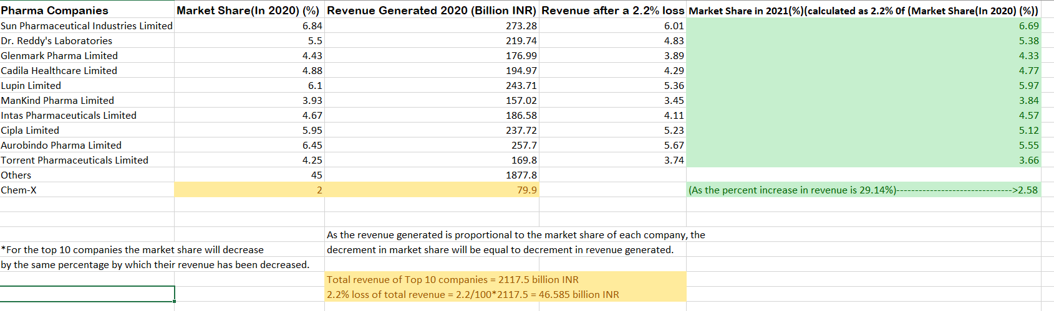
Q1.A
ChemX share from the loss revenue = 23.292 billion INR
Therefore, total revenue of ChemX = 79.9 + 23.292 = 103.19 billion INR
So, the % increase in revenue = (103.19-79.9)/79.9 *100 = 29.14%
Thus, the increase in market share of ChemX in 2021 = 0.2914*2 + 2 = 2.5828%
The market share of all top 10 companies has been calculated as
→ X – 0.022*X, where X is the current market share.
The answer is in green

Slide 5
Q1.B
Total revenue generated by ChemX in 2021 if the overall generation for individual companies is increased by 5% of that in 2020
→(0.05*103.19+103.19) billion INR = 108.35 billion INR

Slide 6
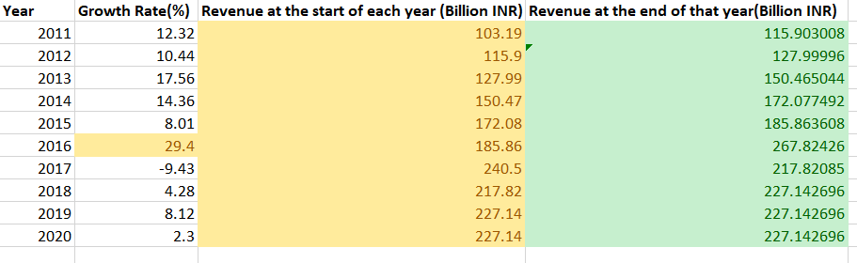
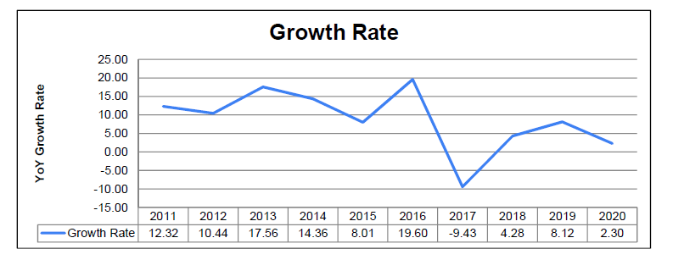
Q2
The answer is in green

Slide 7
Thank You, Team Data Geeks

